Slide 1
Cluster Analysis
COSC 757 Data Mining, Spring 2016

Slide 2
What is Cluster Analysis
Cluster: A collection of data objects
similar (or related) to one another within the same group
dissimilar (or unrelated) to the objects in other groups
Cluster analysis (or clustering, data segmentation, …)
Finding similarities between data according to the characteristics found in the data and grouping similar data objects into clusters
Unsupervised learning: no predefined classes (i.e., learning by observations vs. learning by examples: supervised)
Typical applications
As a stand-alone tool to gain insight into data distribution
As a preprocessing step for other algorithms

Slide 3
Clustering Examples
Biology: taxonomy of living things: kingdom, phylum, class, order, family, genus and species
Information retrieval: document clustering
Land use: Identification of areas of similar land use in an earth observation database
Marketing: Help marketers discover distinct groups in their customer bases, and then use this knowledge to develop targeted marketing programs
City-planning: Identifying groups of houses according to their house type, value, and geographical location
Earth-quake studies: Observed earth quake epicenters should be clustered along continent faults
Climate: understanding earth climate, find atmospheric and oceanic paterns
Economic Science: market resarch

Slide 4
Clustering as a Preprocessing Tool
Summarization:
Preprocessing for regression, PCA, classification, and association analysis
Compression:
Image processing: vector quantization
Finding K-nearest Neighbors
Localizing search to one or a small number of clusters
Outlier detection
Outliers are often viewed as those “far away” from any cluster

Slide 5
Quality: What is Good Clustering?
A good clustering method will produce high quality clusters
high intra-class similarity: cohesive within clusters
low inter-class similarity: distinctive between clusters
The quality of a clustering method depends on
the similarity measure used by the method
its implementation, and
Its ability to discover some or all of the hidden patterns

Slide 6
Cluster Quality
Dissimilarity/Similarity metric
Expressed in terms of a distance function, typically metric:
d(i, j)
The definitions of distance functions are usually rather different for interval-scaled, boolean, categorical, ordinal ratio, and vector variables
Weights should be associated with different variables based on applications and data semantics
Quality of clustering:
There is usually a separate “quality” function that measures the “goodness” of a cluster.
It is hard to define “similar enough” or “good enough”
The answer is typically highly subjective

Slide 7
Considerations for Cluster Analysis
Partitioning criteria
Single level vs. hierarchical partitioning (often, multi-level hierarchical partitioning is desirable)
Separation of clusters
Exclusive (e.g., one customer belongs to only one region)
Non-exclusive (e.g., one document may belong to more than one class)
Similarity measure
Distance-based (e.g., Euclidian, road network, vector) vs. connectivity-based (e.g., density or contiguity)
Clustering space
Full space (often when low dimensional) vs. subspaces (often in high-dimensional clustering)

Slide 8
Requirements and Challenges
Scalability
Clustering all the data instead of only on samples
Ability to deal with different types of attributes
Numerical, binary, categorical, ordinal, linked, and mixture of these
Constraint-based clustering
User may give inputs on constraints
Use domain knowledge to determine input parameters
Interpretability and usability
Others
Discovery of clusters with arbitrary shape
Ability to deal with noisy data
Incremental clustering and insensitivity to input order
High dimensionality

Slide 9
Major Clustering Approaches (1)
Partitioning approach:
Construct various partitions and then evaluate them by some criterion, e.g., minimizing the sum of square errors
Typical methods: k-means, k-medoids, CLARANS
Hierarchical approach:
Create a hierarchical decomposition of the set of data (or objects) using some criterion
Typical methods: Diana, Agnes, BIRCH, CAMELEON
Density-based approach:
Based on connectivity and density functions
Typical methods: DBSCAN, OPTICS, DenClue
Grid-based approach:
based on a multiple-level granularity structure
Typical methods: STING, WaveCluster, CLIQUE

Slide 10
Major Clustering Approaches (2)
Model-based:
A model is hypothesized for each of the clusters and tries to find the best fit of that model to each other
Typical methods: EM, SOM, COBWEB
Frequent pattern-based:
Based on the analysis of frequent patterns
Typical methods: p-Cluster
User-guided or constraint-based:
Clustering by considering user-specified or application-specific constraints
Typical methods: COD (obstacles), constrained clustering
Link-based clustering:
Objects are often linked together in various ways
Massive links can be used to cluster objects: SimRank, LinkClus

Slide 11
Partitioning Algorithms: Basic Concept
Partitioning method: Partitioning a database D of n objects into a set of k clusters, such that the sum of squared distances is minimized (where c_{i} is the centroid or medoid of cluster C_{i})
Given k, find a partition of k clusters that optimizes the chosen partitioning criterion
Global optimal: exhaustively enumerate all partitions
Heuristic methods: k-means and k-medoids algorithms
k-means (MacQueen’67, Lloyd’57/’82): Each cluster is represented by the center of the cluster
k-medoids or PAM (Partitioning around medoids) (Kaufman & Rousseeuw’87): Each cluster is represented by one of the objects in the cluster

Slide 12
The K-means Clustering Method
Given k, the k-means algorithm is implemented in four steps:
Partition objects into k nonempty subsets
Compute seed points as the centroids of the clusters of the current partitioning (the centroid is the center, i.e., mean point, of the cluster)
Assign each object to the cluster with the nearest seed point
Go back to Step 2, stop when the assignment does not change

Slide 13
K-means Example
K=2
Arbitrarily partition objects into k groups
Update the cluster centroids
The initial data set
Loop if needed
Reassign objects
Partition objects into k nonempty subsets
Repeat
Compute centroid (i.e., mean point) for each partition
Assign each object to the cluster of its nearest centroid
Until no change
Update the cluster centroids

Slide 14
Comments on the K-means Method
Strength: Efficient: O(tkn), where n is # objects, k is # clusters, and t is # iterations. Normally, k, t << n.
Comparing: PAM: O(k(n-k)² ), CLARA: O(ks² + k(n-k))
Comment: Often terminates at a local optimal. (Greedy)
Weakness
Applicable only to objects in a continuous n-dimensional space
Using the k-modes method for categorical data
In comparison, k-medoids can be applied to a wide range of data
Need to specify k, the number of clusters, in advance (there are ways to automatically determine the best k (see Hastie et al., 2009)
Sensitive to noisy data and outliers
Not suitable to discover clusters with non-convex shapes

Slide 15
R Demo

Slide 16
Variations of the K-means Method
Most of the variants of the k-means which differ in
Selection of the initial k means
Dissimilarity calculations
Strategies to calculate cluster means
Handling categorical data: k-modes
Replacing means of clusters with modes
Using new dissimilarity measures to deal with categorical objects
Using a frequency-based method to update modes of clusters
A mixture of categorical and numerical data: k-prototype method

Slide 17
K-Medoids
The k-means algorithm is sensitive to outliers
Since an object with an extremely large value may substantially distort the distribution of the data
K-Medoids: Instead of taking the mean value of the object in a cluster as a reference point, medoids can be used, which is the most centrally located object in a cluster
10
10
9
9
8
8
7
7
6
6
5
5
4
4
3
3
2
2
1
1
0
0
1
2
3
4
5
6
7
8
9
10
0
0
1
2
3
4
5
6
7
8
9
10

Slide 18

PAM: A Typical K-Medoids Algorithm
Total Cost = 20
10
9
8
Arbitrarily choose k objects as initial medoids
Assign each remaining object to nearest medoids
7
6
5
4
3
2
1
0
0
1
2
3
4
5
6
7
8
9
10
K=2
Randomly select a nonmedoid object,O_{ramdom}
Total Cost = 26
Do loop
Until no change
10
Compute total cost of swapping
10
Swapping O and O_{ramdom}
If quality is improved.
9
9
8
8
7
7
6
6
5
5
4
4
3
3
2
2
1
1
0
0
1
2
3
4
5
6
7
8
9
10
0
0
1
2
3
4
5
6
7
8
9
10

Slide 19
The K-medoid Clustering Method
K-Medoids Clustering: Find representative objects (medoids) in clusters
PAM (Partitioning Around Medoids, Kaufmann & Rousseeuw 1987)
Starts from an initial set of medoids and iteratively replaces one of the medoids by one of the non-medoids if it improves the total distance of the resulting clustering
PAM works effectively for small data sets, but does not scale well for large data sets (due to the computational complexity)
Efficiency improvement on PAM
CLARA (Kaufmann & Rousseeuw, 1990): PAM on samples
CLARANS (Ng & Han, 1994): Randomized re-sampling

Slide 20
R Demo

Slide 21
Hierarchical Clustering
Use distance matrix as clustering criteria. This method does not require the number of clusters k as an input, but needs a termination condition
Step 0
Step 1
Step 2
Step 3
Step 4
agglomerative
(AGNES)
a
a b
b
a b c d e
c
c d e
d
d e
e
divisive
(DIANA)
Step 4
Step 3
Step 2
Step 1
Step 0

Slide 22
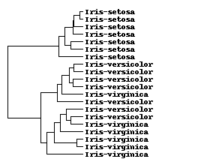
Dendrogram

Slide 23
AGNES (Agglomerative Nesting)
Introduced in Kaufmann and Rousseeuw (1990)
Use the single-linkage method and the dissimilarity matrix
Merge nodes that have the lowest dissimilarity
Progress in a non-descending fashion
Eventually all nodes belong to the same cluster

Slide 24
DIANA (Divisive Analysis)
Introduced in Kaufmann and Rousseeuw (1990)
Implemented in statistical analysis packages
Inverse order of AGNES
Eventually each node forms a cluster on its own

Slide 25
Distance Between Hierarchical Clusters
A core need is to be able to measure the distance between two hierarchical clusters.
Single linkage: smallest distance between an element in one cluster and an element in the other, i.e., dist(K_{i}, K_{j}) = min(t_{ip}, t_{jq})
Complete linkage: largest distance between an element in one cluster and an element in the other, i.e., dist(K_{i}, K_{j}) = max(t_{ip}, t_{jq})
Average linkage: avg distance between an element in one cluster and an element in the other, i.e., dist(K_{i}, K_{j}) = avg(t_{ip}, t_{jq})
Centroid: distance between the centroids of two clusters, i.e., dist(K_{i}, K_{j}) = dist(C_{i}, C_{j})
Medoid: distance between the medoids of two clusters, i.e., dist(K_{i}, K_{j}) = dist(M_{i}, M_{j})
Medoid: a chosen, centrally located object in the cluster

Slide 26
Single Linkage Example (Agglomerative)
2 | 5 | 9 | 15 | 16 | 18 | 25 | 33 | 33 | 45
2,5
15,16
33,33
2,5,9
2,5,9,15,16,18
15,16,18
2,5,9,15,16,18,25
2,5,9,15,16,18,25,33,33
2,5,9,15,16,18,25,33,33,45

Slide 27
Complete Linkage Example (Agglomerative)
2 | 5 | 9 | 15 | 16 | 18 | 25 | 33 | 33 | 45
2,5
15,16
33,33
2,5,9
2,5,9,15,16,18
15,16,18
2,5,9,15,16,18,25,33,33,45
25,33,33
25,33,33,45

Slide 28
R Demo

Slide 29
Extensions to Hierarchical Clustering
Major weakness of agglomerative clustering methods
Can never undo what was done previously
Do not scale well: time complexity of at least O(n²), where n is the number of total objects
Integration of hierarchical & distance-based clustering
BIRCH (1996): uses CF-tree and incrementally adjusts the quality of sub-clusters
CHAMELEON (1999): hierarchical clustering using dynamic modeling

Slide 30
BIRCH (Balanced iterative Reducing and Clustering Using Hierarchies
Zhang, Ramakrishnan & Livny, SIGMOD’96
Integrates hierarchical clustering and iterative partitioning
Incrementally construct a CF (Clustering Feature) tree, a hierarchical data structure for multiphase clustering
Phase 1: scan DB to build an initial in-memory CF tree (a multi-level compression of the data that tries to preserve the inherent clustering structure of the data)
Phase 2: use an arbitrary clustering algorithm to cluster the leaf nodes of the CF-tree
Scales linearly: finds a good clustering with a single scan and improves the quality with a few additional scans
Weakness: handles only numeric data, and sensitive to the order of the data record

Slide 31
Clustering Feature Vector in BIRCH
Clustering Feature (CF): CF = (N, LS, SS)
N: Number of data points
LS: linear sum of N points:
SS: square sum of N points
CF = (5, (16,30),(54,190))
(3,4)
(2,6)
(4,5)
(4,7)
(3,8)

Slide 32
CF-Tree in BIRCH
Clustering feature:
Summary of the statistics for a given subcluster
Registers crucial measurements for computing cluster and utilizes storage efficiently
A CF tree is a height-balanced tree that stores the clustering features for a hierarchical clustering
A nonleaf node in a tree has descendants or “children”
The nonleaf nodes store sums of the CFs of their children
A CF tree has two parameters
Branching factor: max # of children
Threshold: max diameter of sub-clusters stored at the leaf nodes

Slide 33
The CF Tree Structure
Root
CF₁
CF₂
CF₃
CF₆
child₁
child₂
child₃
child₆
Non-leaf node
CF₁
CF₂
CF₃
CF₅
child₁
child₂
child₃
child₅
Leaf node
Leaf node
prev
CF₁
CF₂
CF₆
next
prev
CF₁
CF₂
CF₄
next

Slide 34
The BIRCH Algorithm
For each point in the input
Find closest leaf entry
Add point to leaf entry and update CF
If entry diameter > max_diameter, then split leaf, and possibly parents
Algorithm is O(n)
Concerns
Sensitive to insertion order of data points (not order invariant)
Since we fix the size of leaf nodes, so clusters may not be so natural
Clusters tend to be spherical given the radius and diameter measures

Slide 35
CHAMELEON: Hierarchical Clustering Using Dynamic Modeling (1999)
CHAMELEON: G. Karypis, E. H. Han, and V. Kumar, 1999
Measures the similarity based on a dynamic model
Two clusters are merged only if the interconnectivity and closeness (proximity) between two clusters are high relative to the internal interconnectivity of the clusters and closeness of items within the clusters
Graph-based, and a two-phase algorithm
Use a graph-partitioning algorithm: cluster objects into a large number of relatively small sub-clusters
Use an agglomerative hierarchical clustering algorithm: find the genuine clusters by repeatedly combining these sub-clusters

Slide 36
Overall Framework of CHAMELEON
Construct (K-NN)
Sparse Graph
Partition the Graph
Data Set
K-NN Graph
P and q are connected if q is among the top k closest neighbors of p
Merge Partition
Relative interconnectivity: connectivity of c₁ and c₂ over internal connectivity
Relative closeness: closeness of c₁ and c₂ over internal closeness
Final Clusters

Slide 37
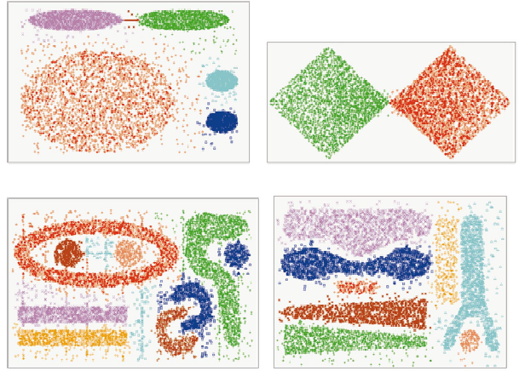
CHAMELEON (Complex Objects)

Slide 38
Probabilistic Hierarchical Clustering
Algorithmic hierarchical clustering
Nontrivial to choose a good distance measure
Hard to handle missing attribute values
Optimization goal not clear: heuristic, local search
Probabilistic hierarchical clustering
Use probabilistic models to measure distances between clusters
Generative model: Regard the set of data objects to be clustered as a sample of the underlying data generation mechanism to be analyzed
Easy to understand, same efficiency as algorithmic agglomerative clustering method, can handle partially observed data
In practice, assume the generative models adopt common distributions functions, e.g., Gaussian distribution or Bernoulli distribution, governed by parameters

Slide 39

Generative Model
Given a set of 1-D points X = {x₁, …, x_{n}} for clustering analysis & assuming they are generated by a Gaussian distribution:
The probability that a point x_{i} ∈ X is generated by the model
The likelihood that X is generated by the model:
The task of learning the generative model: find the parameters μ and σ² such that
the maximum likelihood

Slide 40

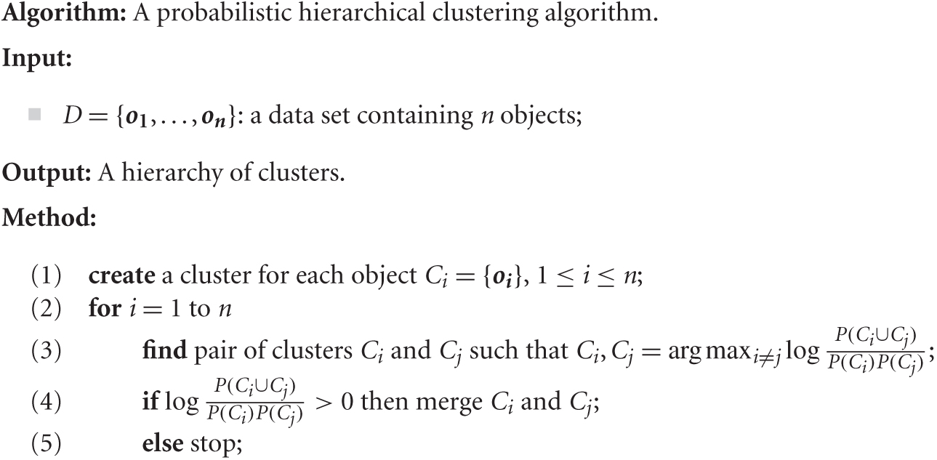
A Probabilistic Hierarchical Clustering Algorithm
For a set of objects partitioned into m clusters C₁, . . . ,C_{m}, the quality can be measured by,
where P() is the maximum likelihood
Distance between clusters C₁ and C₂:

Slide 41
Density-Based Clustering
Clustering based on density (local cluster criterion), such as density-connected points
Major features:
Discover clusters of arbitrary shape
Handle noise
One scan
Need density parameters such as termination criteria
p
p₁
q
p
q
o

Slide 42
Density-Based Clustering: Basic Concepts
Two parameters:
Eps: Maximum radius of the neighborhood
MinPts: Minimum number of points in an Eps-neighborhood (N_{Eps}) of that point
Directly density-reachable: A point p is directly density-reachable from a point q w.r.t. Eps, MinPts if
p belongs to N_{Eps}(q)
core point condition:
|N_{Eps} (q)| ≥ MinPts
p
MinPts = 5
Eps = 1 cm
q

Slide 43
Density-Reachable and Density-Connected
Density-reachable:
A point p is density-reachable from a point q w.r.t. Eps, MinPts if there is a chain of points p₁, …, p_{n}, p₁ = q, p_{n} = p such that p_{i+1} is directly density-reachable from p_{i}
Density-connected
A point p is density-connected to a point q w.r.t. Eps, MinPts if there is a point o such that both, p and q are density-reachable from o w.r.t. Eps and MinPts
p
p₁
q
p
q
o

Slide 44
DBSCAN: Density-Based Spatial Clustering of Applications with Noise
Relies on a density-based notion of cluster: A cluster is defined as a maximal set of density-connected points
Discovers clusters of arbitrary shape in spatial databases with noise
Border
Outlier
Eps = 1cm
MinPts = 5
Core

Slide 45
DBSCAN: The Algorithm
Arbitrary select a point p
Retrieve all points density-reachable from p w.r.t. Eps and MinPts
If p is a core point, a cluster is formed
If p is a border point, no points are density-reachable from p and DBSCAN visits the next point of the database
Continue the process until all of the points have been processed

Slide 46
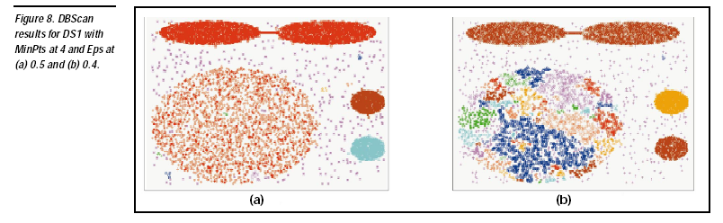

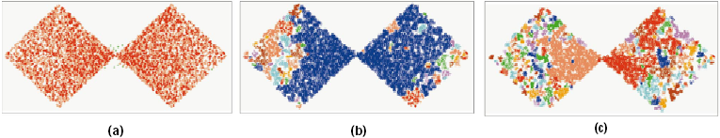
DBSCAN: Sensitive to Parameters

Slide 47
DBSCAN Demo

Slide 48
Kohonen Networks for Clustering
Uses self organizing map (SOM) which is a type of neural network
SOM converts a complex high-dimensional input signal into a simpler low-dimensional discrete map.
SOMs structure output nodes into clusters of nodes
Nodes with closer proximity are more similar

Slide 49
Competitive Learning
Output nodes compete among themselves to be the winning node (or neuron)
Neurons become tuned to various input patterns
SOMs are feed forward and completely connected
Each connection has a weight associated with it
Adjusting weights is the key for the learning mechanism

Slide 50
SOM Intuition
SOMs have no hidden layer
Data from the input layer are passed along directly to the output layer
The output layer is represented in the form of a lattice.
For a given instance, a particular field value is forwarded from a particular input node to every output node
A scoring function is then used to designate the winning node

Slide 51
Kohonen Networks
SOMs that exhibit Kohonen learning (Kohonen, 89)
Given
input vector x_{n}= x_{n1}, x_{n2},… x_{n3}
weights vector w_{j} = w_{1j}, w_{2j},… w_{3j}
In Kohonen learning the nodes in the neighborhood of the winning node adjust their weights using a linear combination of the input vector and the current weight vector
w_{ij,new} = w_{ij.current} + η(x_{ni} - w_{ij,current})
The weights are initialized as random values
Parameters include the learning rate η and the neighborhood size R
Both η and R should start out large and decrease as the algorithm progresses

Slide 52
Kohonen Network Algorithm
For each input vector do:
Competition: For each output node j, calculate the value D(w_{j} ,x_{n}) of the scoring function (e.g. Euclidean Distance) and find the winning node that minimizes D(w_{j} ,x_{n}) over all output nodes
Cooperation: Identify all output nodes j within the neighborhood of J defined by the neighborhood size R. For these nodes, do the following for all input fields:
Adaptation: Adjust the weights:
w_{ij,new} = w_{ij.current} + η(x_{ni} - w_{ij,current})
Adjust the learning rate and neighborhood size, as needed
Stop when the termination criteria are met (e.g. maximum number of iterations)

Slide 53
Kohonen Network Example
η = 0.5
R = 0
Input Data
Weights
Age (1) | Income (2)
0.8 | 0.8
0.8 | 0.1
0.1 | 0.8
0.1 | 0.2
 | Age (1) | Income (2)
Node1 | 0.9 | 0.8
Node 2 | 0.9 | 0.2
Node 3 | 0.1 | 0.8
Node 4 | 0.1 | 0.2
Node 1
Node 2
Node 3
Node 4
w_{2,1}
w_{1,4}
Competition:
w_{1,3}
w_{2,2}
x₁= (0.8,0.8)
D(w₁ ,x₁) = 0.1
D(w₂ ,x₁) = 0.61
D(w₃ ,x₁) = 0.70
D(w₄ ,x₁) = 0.92
w_{1,1}
w_{1,2}
w_{2,3}
w_{2,4}
Adaptation:
Age
Income
w_{ij,new} = w_{ij.current} + η(x_{ni} - w_{ij,current})
For age: 0.9 + 0.5(0.8-0.9) = 0.85
For Income: 0.8 + 0.5(0.8-0.8) = 0.8

Slide 54
Kohonen Network Example
η = 0.5
R = 0
Input Data
Weights
Age (1) | Income (2)
0.8 | 0.8
0.8 | 0.1
0.2 | 0.9
0.1 | 0.1
 | Age (1) | Income (2)
Node1 | 0.85 | 0.8
Node 2 | 0.9 | 0.2
Node 3 | 0.1 | 0.8
Node 4 | 0.1 | 0.2
Node 1
Node 2
Node 3
Node 4
w_{2,1}
w_{1,4}
Competition:
w_{1,3}
w_{2,2}
x₂= (0.8,0.1)
D(w₁ ,x₁) = 0.71
D(w₂ ,x₁) = 0.14
D(w₃ ,x₁) = 0.99
D(w₄ ,x₁) = 0.78
w_{1,1}
w_{1,2}
w_{2,3}
w_{2,4}
Adaptation:
Age
Income
w_{ij,new} = w_{ij.current} + η(x_{ni} - w_{ij,current})
For age: 0.9 + 0.5(0.8-0.9) = 0.85
For Income: 0.2 + 0.5(0.1-0.2) = 0.15

Slide 55
Kohonen Network Example
η = 0.5
R = 0
Input Data
Weights
Age (1) | Income (2)
0.8 | 0.8
0.8 | 0.1
0.2 | 0.9
0.1 | 0.1
 | Age (1) | Income (2)
Node1 | 0.85 | 0.8
Node 2 | 0.85 | 0.15
Node 3 | 0.1 | 0.8
Node 4 | 0.1 | 0.2
Node 1
Node 2
Node 3
Node 4
w_{2,1}
w_{1,4}
Competition:
w_{1,3}
w_{2,2}
x₃= (0.2,0.9)
D(w₁ ,x₁) = 0.66
D(w₂ ,x₁) = 0.99
D(w₃ ,x₁) = 0.14
D(w₄ ,x₁) = 0.71
w_{1,1}
w_{1,2}
w_{2,3}
w_{2,4}
Adaptation:
Age
Income
w_{ij,new} = w_{ij.current} + η(x_{ni} - w_{ij,current})
For age: 0.1 + 0.5(0.2-0.1) = 0.15
For Income: 0.8 + 0.5(0.9-0.2) = 0.85

Slide 56
Kohonen Network Example
η = 0.5
R = 0
Input Data
Weights
Age (1) | Income (2)
0.8 | 0.8
0.8 | 0.1
0.2 | 0.9
0.1 | 0.1
 | Age (1) | Income (2)
Node1 | 0.85 | 0.8
Node 2 | 0.85 | 0.15
Node 3 | 0.15 | 0.85
Node 4 | 0.1 | 0.2
Node 1
Node 2
Node 3
Node 4
w_{2,1}
w_{1,4}
Competition:
w_{1,3}
w_{2,2}
x₄= (0.1,0.1)
D(w₁ ,x₁) = 1.03
D(w₂ ,x₁) = 0.75
D(w₃ ,x₁) = 0.75
D(w₄ ,x₁) = 0.1
w_{1,1}
w_{1,2}
w_{2,3}
w_{2,4}
Adaptation:
Age
Income
w_{ij,new} = w_{ij.current} + η(x_{ni} - w_{ij,current})
For age: 0.1 + 0.5(0.1-0.1) = 0.1
For Income: 0.8 + 0.5(0.1-0.2) = 0.15

Slide 57
Kohonen Network Example
η = 0.5
R = 0
Input Data
Weights
Age (1) | Income (2)
0.8 | 0.8
0.8 | 0.1
0.2 | 0.9
0.1 | 0.1
 | Age (1) | Income (2)
Node1 | 0.85 | 0.8
Node 2 | 0.85 | 0.15
Node 3 | 0.15 | 0.85
Node 4 | 0.1 | 0.15
Node 1
Node 2
Node 3
Node 4
w_{2,1}
w_{1,4}
w_{1,3}
w_{2,2}
w_{1,1}
w_{1,2}
w_{2,3}
w_{2,4}
 | Associated With | Description
Cluster 1 | Node1 | Older person with high income
Cluster 2 | Node 2 | Older person with low income
Cluster 3 | Node 3 | Younger person with high income
Cluster 4 | Node 4 | Younger person with low income
Age
Income

Slide 58
Evaluation of Clustering
Assessing Cluster Tendency
Assess whether a non-random structure exists in the data
Measuring Cluster Validity
How good are the resulting clusters?
Determining the number of clusters
Estimate this number before applying clustering

Slide 59
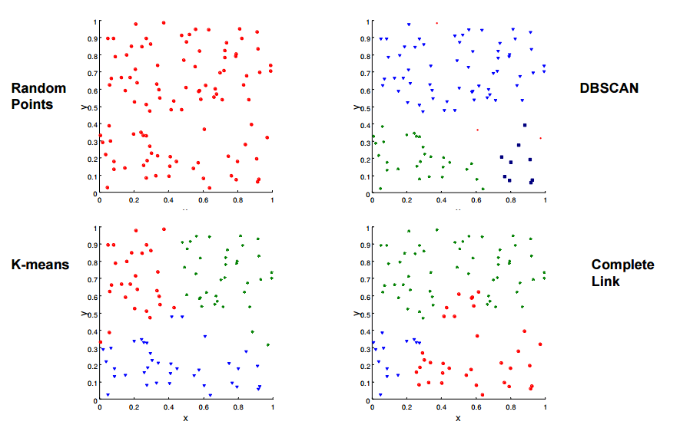
Assessing Clustering Tendency
What happens when we cluster a completely random dataset?

Slide 60
Hopkins Statistic
Given a dataset D regarded as a sample of a random variable o, determine how far away o is from being uniformly distributed in the data space
Sample n points, p₁, …, p_{n}, uniformly from D. For each p_{i}, find its nearest neighbor in D: x_{i} = min{dist (p_{i}, v)} where v in D
Sample n points, q₁, …, q_{n}, uniformly from D. For each q_{i}, find its nearest neighbor in D – {q_{i}}: y_{i} = min{dist (q_{i}, v)} where v in D and v ≠ q_{i}
Calculate the Hopkins Statistic:
If D is uniformly distributed, ∑ x_{i} and ∑ y_{i} will be close to each other and H is close to 0.5.
H > 0.75 indicates a clustering tendency at the 90% confidence level.

Slide 61
Measuring Cluster Quality
Two methods: extrinsic vs. intrinsic
Extrinsic (external): supervised (i.e. ground truth data is available)
Compare a clustering against the ground truth using certain clustering quality measure
Intrinsic (internal): unsupervised (i.e. ground truth data is unavailable)
Evaluate the goodness of a clustering by considering how well the clusters are separated, and how compact the clusters are

Slide 62
Extrinsic Methods: Criteria
Clustering quality measure: Q(C, C_{g}), for a clustering C given the ground truth C_{g}.
Q is good if it satisfies the following 4 essential criteria
Cluster homogeneity: the purer, the better
Cluster completeness: should assign objects belong to the same category in the ground truth to the same cluster
Rag bag: putting a heterogeneous object into a pure cluster should be penalized more than putting it into a rag bag (i.e., “miscellaneous” or “other” category)
Small cluster preservation: splitting a small category into pieces is more harmful than splitting a large category into pieces

Slide 63
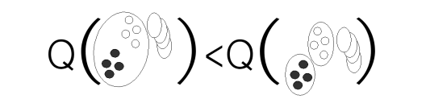
Homogeneity

Slide 64
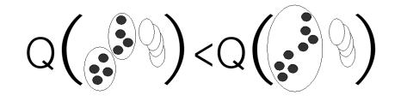
Completeness

Slide 65
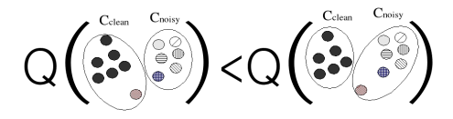
Rag Bag

Slide 66
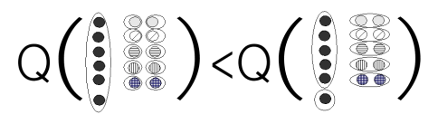
Small Cluster Preservation

Slide 67
BCubed Metric
Based on precision and recall statistics between clusters and ground truth
Has been shown to satisfy 4 constraints
Homogeneity
Splitting a cluster that mixes two categories into two “pure” clusters increases the BCubed precision and does not affect BCubed recall
Completeness
Unifying two clusters which contain only items from the same category increases the Bcubed recall measure and the precision remains maximal
Rag Bag
Introducing a unique item in a clean cluster decreases the precision and the recall is unaffected
Cluster Size
Splitting small clusters decreases recall

Slide 68
Intrinsic Methods
Used when the ground truth of a dataset is not available
Evaluate clusters based on how well they are separated and how compact they are
Intrinsic methods typically have the advantage of a similarity metric

Slide 69
Using Correlation
Two matrices:
Proximity Matrix
Incidence Matrix
One row and one column for each data point
An entry is 1 if the associated pair of points belong to the same cluster
An entry is 0 if the associated pair of points belongs to different clusters
Compute the correlation between the two matrices

Slide 70
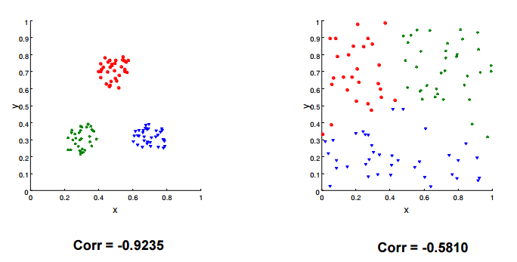
Measuring Cluster Validity Via Correlation

Slide 71
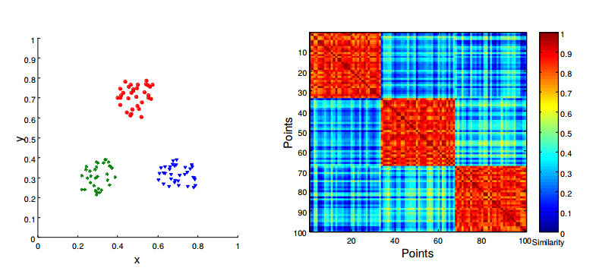
Use Similarity Matrix
Order the similarity matrix with respect to cluster labels (visual inspection)

Slide 72
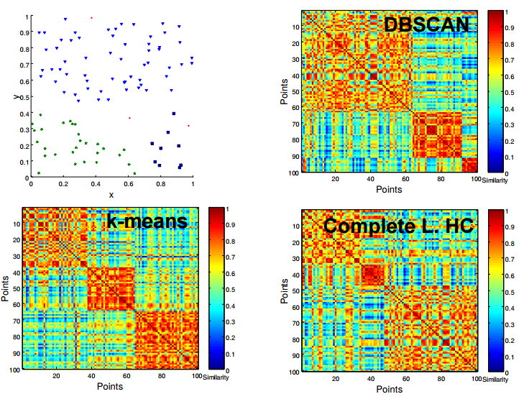
Similarity Matrix for Random Data

Slide 73
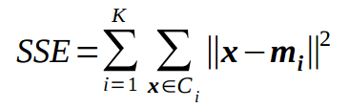
Sum of Squares (SSE)
SSE is good for comparing two clusters (average SSE)
Can also be used to estimate the number of clusters

Slide 74
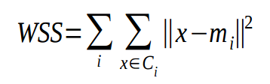

Cohesion and Separation
Cluster Cohesion: Measures how closely related objects are in a cluster:
Within cluster sum of squares:
Cluster Separation: Measure how distinct or well separated a cluster is from other clusters
Between cluster sum of squares
Total sum of squares TSS=WSS+BSS

Slide 75
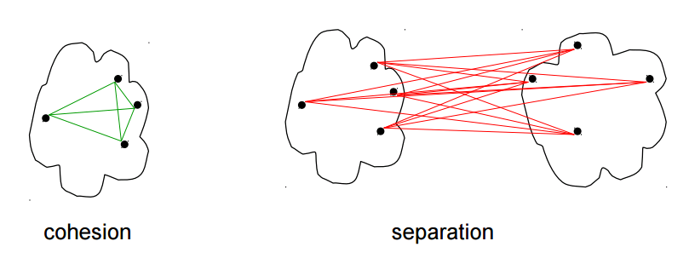
Proximity Graph for Cohesion and Separation
A proximity graph-based approach can also be used for cohesion and separation.
Cohesion is the sum of the weights of all links within a cluster
Separation is the sum of the weights between nodes in the cluster and nodes outside the cluster

Slide 76
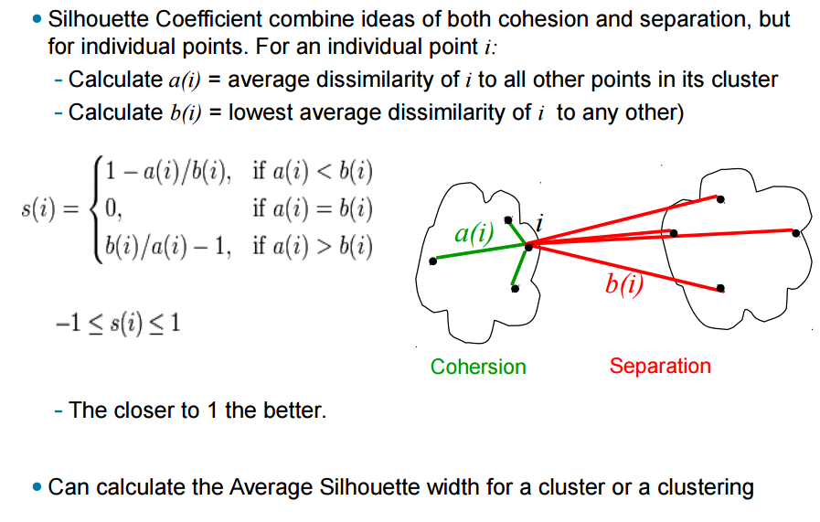
Silhouette Coefficient

Slide 77
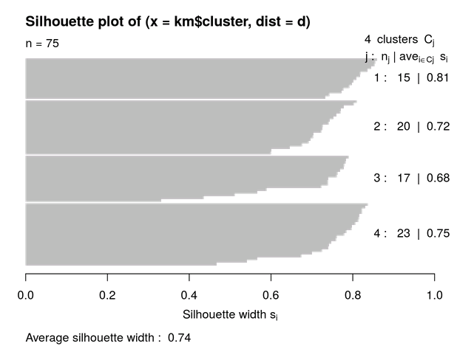
Silhouette Plot

Slide 78
Determine the Number of Clusters
Empirical method
# of clusters ≈√n/2 for a dataset of n points
Elbow method
Use the turning point in the curve of sum of within cluster variance with respect to the # of clusters
Cross validation method
Divide a given data set into m parts
Use m – 1 parts to obtain a clustering model
Use the remaining part to test the quality of the clustering
E.g., For each point in the test set, find the closest centroid, and use the sum of squared distance between all points in the test set and the closest centroids to measure how well the model fits the test set
For any k > 0, repeat it m times, compare the overall quality measure with respect to different k’s, and find # of clusters that fits the data the best

Slide 79
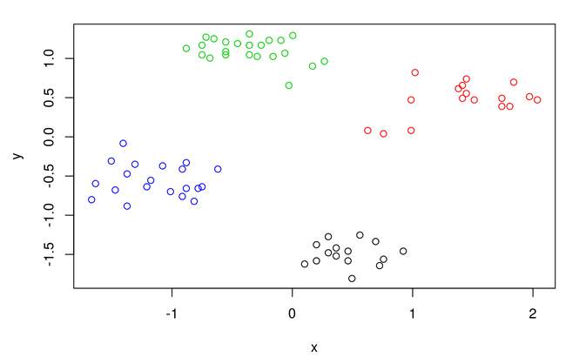
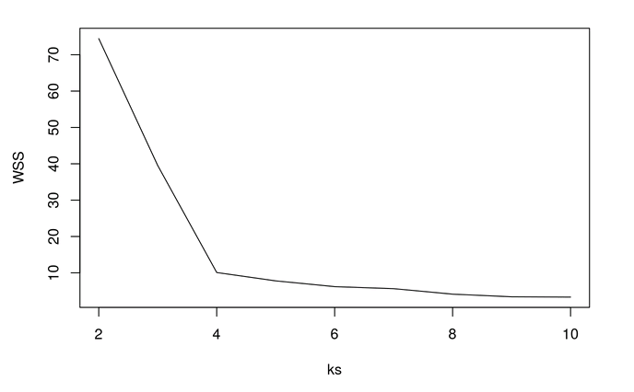
Elbow Method Using SSE

Slide 80
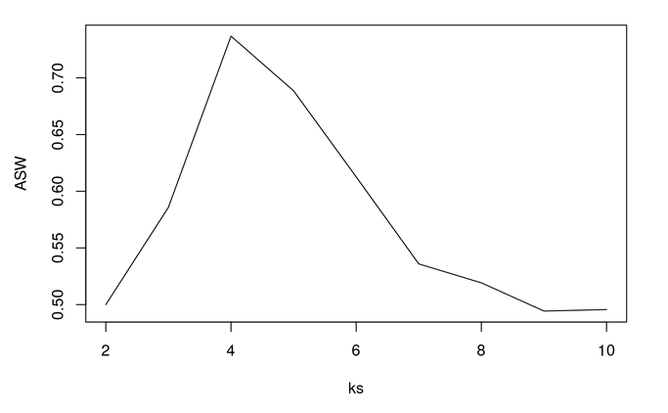
Elbow Method using Average Sillouette

